Slide 1
Fire Behavior & Modern Fire Behavior

Slide 2
ENABLING OBJECTIVES
Identify the Science of Fire
Define The methods of Heat transfer
Compare the characteristics of each class of fire
Discuss fire behavior in a structure
Define Legacy Fuels vs Modern Fuels
IDENTIFY MODERN FIREFIGHTING TACTICS

Slide 3
Why Do we need to understand the science behind fire ?
To better understand and fight fire more effectively
To be able to predict what fire will do in different environments
To be able to change and adapt strategies and Tactics with changing fire conditions and behaviors

Slide 4
SCIENCE OF FIRE: MATTER
MATTER IS ANYTHING THAT OCCUPIES SPACE AND HAS MASS
CAN UNDERGO PHYSICAL CHANGES DUE TO HEAT AND PRESSURE
Usually there is a transfer of energy whenever there is a physical change to matter

Slide 5
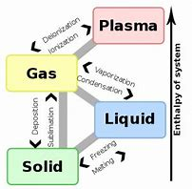
Science OF FIRE: MATTER
MATTER EXISTS IN 4 STATES
LIQUID
SOLID
GASEOUS
PLASMA - NOT APPLICABLE IN THE FIRE SERVICE

Slide 6
SCIENCE OF FIRE: MATTER
• MATTER = FUEL
ONLY GASES BURN
MATTER IS CONVERTED THROUGH
PYROLYSIS
VAPORIZATION

Slide 7
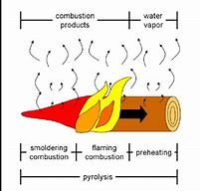
SCIENCE OF FIRE: MATTER
PYROLISIS
The chemical decomposition of a substance through the action of heat which results in a lowered ignition temperature.
As solid fuels are heated, combustible materials are driven from the substancE

Slide 8
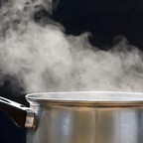
SCIENCE OF FIRE: MATTER
VAPORIZATION
The transformation of a liquid to its vapor or gaseous state

Slide 9
SCIENCE OF FIRE
POTENTIAL ENERGY
STORED ENERGY
CONVERTED TO KINETIC ENERGY WHEN RELEASED

Slide 10
SCIENCE OF FIRE
OXIDATION
CHEMICAL REACTION INVOLVING OXYGEN WITH OTHER MATERIALS
SLOW – RUST
FAST – COMBUSTION OF METHANE

Slide 11
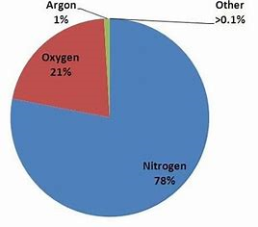
SCIENCE OF FIRE
ATMOSPHERIC COMPOSITION
78% NITROGEN
21% OXYGEN
1% TRACE GASES

Slide 12
SCIENCE OF FIRE
FIRE
Rapid self-sustaining oxidation accompanied by heat and light of varying intensities
ENDOTHERMIC REACTION
CHEMICAL REACTION IN WHICH SUBSTANCE ABSORBS HEAT
EXOTHERMIC REACTION
CHEMICAL REACTION BETWEEN TWO OR MORE MATERIALS THAT CHANGE MATERIALS AND PRODUCE HEAT, FLAMES AND TOXIC SMOKE

Slide 13
SCIENCE OF FIRE
Combustion
Rapid self sustaining exothermic chemical reaction that usually yields heat and light energy as a result i.e. Fire
Modes of combustion
Flaming Combustion
Vaporization
Non-Flaming Combustion
Smoldering

Slide 14
SCIENCE OF FIRE
Triangle must be intact to create a fire
Three elements required for combustion
Fuel
Heat
Oxygen

Slide 15
SCIENCE OF FIRE
Most combustion is incomplete and yields smoke and other gasses
Three fuel types
Solid fuels
Wood, Paper, Cloth and Rubber
Liquid fuels
gasoline, DIESEL Lubricating Oil
Flammable Gases
Acetylene
Hydrogen
Propane
Notes:
Most Combustion is incomplete due to:
• Size and arrangement of fuel
• Contaminants in fuel
• Lack of sufficient oxidize

Slide 16
SCIENCE OF FIRE
3% needed to allow smoldering
6% or lower cannot support human life
10% or lower respiratory arrest
14% - Combustion will not continue
15% needed to sustain flame
18% - Loss of consciousness
19.5 - 21% - Normal air ranges for human life

Slide 17
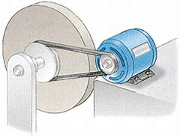
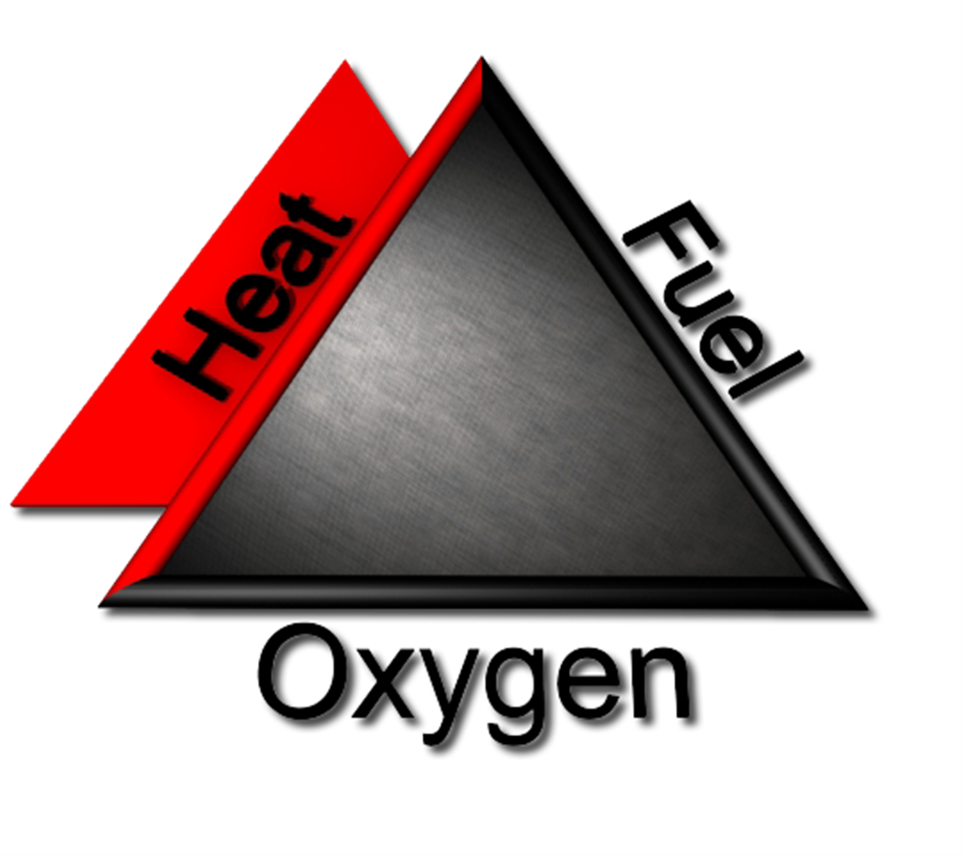
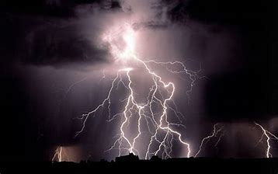
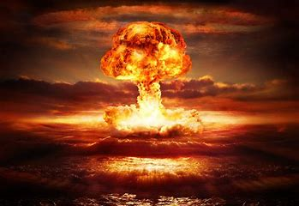
SCIENCE OF FIRE
HEAT ENERGY
MECHANICAL:
HEAT OF COMPREESION
HEAT OF FRICTION
ELECTRICAL
OVER CURRENT/ OVERLOADING
RESISTANCE
ARCHING/SPARKING
CHEMICAL
ENERGY RELEASED AS A RESULT OF A CHEMICAL REACTION IE. COMBUSTION
CAN BE A SLOW PROCESS OR PROGRESS TO SPONTANOEUS IGNITION
NUCLEAR
ENERGY RELEASED AS ATOMS SPLIT OR ARE JOINED TOGETHER
NUCLEAR POWER PLANTS GENERATE POWER AS A RESULT FISSION OF URANIUM

Slide 18
SCIENCE OF FIRE
FIRE TETRAHEDRON
PRODUCT OF THE FIRE TRIANGLES CHEMICAL REACTION
SELF-SUSTAINING CHEMICAL CHAIN REACTION

Slide 19
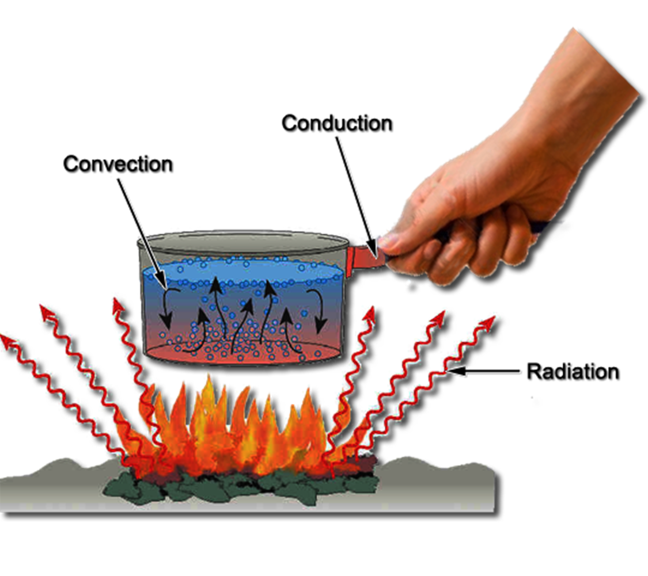
SCIENCE OF FIRE
HEAT TRANSFER
CONDUCTION
Point-to-point transfer of heat energy from one body to another by means of a heat conducting material
Direct contact
CONVECTION
Heat transferred by movement of heated liquids or gases
RADIATION
Transfers heat across an intervening space

Slide 20
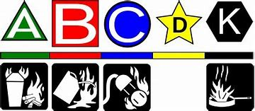
FIRE BEHAVIOR
FUEL
CLASSIFICATION

Slide 21
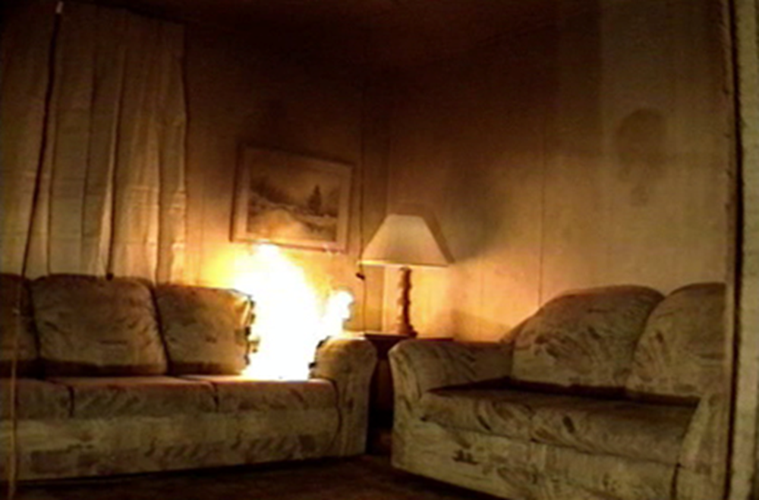
FUEL CLASSIFICATION
CLASS A
ORDINARY COMBUSTIBLES
WOOD
PAPER
PLASTICS

Slide 22
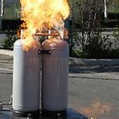
FUEL CLASSIFICATION
CLASS B
Flammable liquids and gases
Gasoline
Propane
Greases

Slide 23
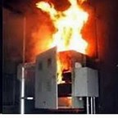
FUEL CLASSIFICATION
CLASS C
• Energized electrical
• As soon as equipment, tool, is de-energized, becomes a class A or B fire

Slide 24
FUEL CLASSIFICATION
CLASS D
Combustible metals
• Zinc
• Magnesium
• Titanium
• Aluminum
• Usually need a specific agent to stop combustion or copious amounts of water

Slide 25
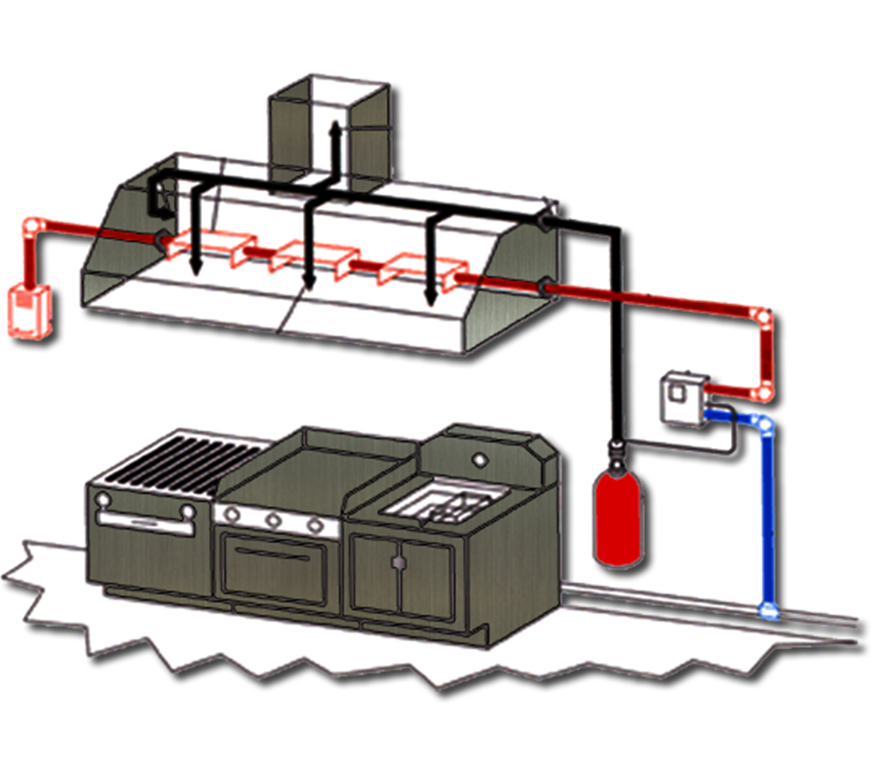
FUEL CLASSIFICATION
Class K
Cooking media
Greases
Cooking fats
Cooking oils
Uses Saponification to extinguish
Common in commercial Kitchens

Slide 26
FIRE BEHAVIOR IN A STRUCTURE
PHASES OF FIRE
5 Phases
Ignition
Growth
Flashover
Fully Developed
Decay

Slide 27
FIRE BEHAVIOR IN A STRUCTURE
Ignition Phase
All 4 Elements of the Fire Tetrahedron Come Together and Combustion Begins
Very Small Fire
21% Oxygen
Low Heat if any at all above Room Temperature

Slide 28
FIRE BEHAVIOR IN A STRUCTURE
Growth Phase
Fire Plume Forms
Hot Fire Gases Spread upward and outward and Move
Across the Ceiling till they reach the Walls
Depth of Gas Layer Begins to Increase at that Time
16% – 20% Oxygen
1000 to 1300 Degrees F° at CeilinG

Slide 29
FIRE BEHAVIOR IN A STRUCTURE
Flashover
All surfaces and objects within a space have been heated to their ignition temperature, and flame breaks out almost at once over the surface of all objects in a space.
16% – 20% Oxygen
900 – 1200 Degrees F° Average Room Temperature
Above 1300 Degrees F° at Ceiling
Very Dangerous Situation for Firefighter

Slide 30
FIRE BEHAVIOR IN A STRUCTURE
Fully Developed Phase
All Combustible Materials in the Room are Involved in the Fire
All Burning Fuels are Releasing the Maximum Amount of Heat Possible.
Large Volumes of Unburned Gases are produced and will Ignite as they find Oxygen

Slide 31
FIRE BEHAVIOR IN A STRUCTURE
Decay Phase
High Temperatures
1000 Degrees F° at Ceiling
Less than 15% Oxygen

Slide 32
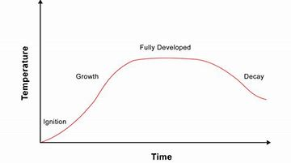
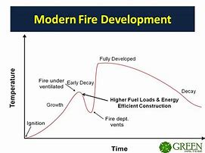
FIRE BEHAVIOR IN A STRUCTURE
TIME TEMPUTURE CURVES
TRADITIONAL VS MODERN
RE-VISIT LATER IN SECTION

Slide 33
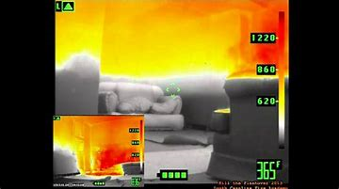
FIRE BEHAVIOR IN A STRUCTURE
THERMAL LAYERING
EXTREME HEAT
MODERATE HEAT
LOW HEAT

Slide 34
FIRE BEHAVIOR IN A STRUCTURE
Higher heat stays up towards ceiling and expands outward until it hits a barrier and begins to bank down
Things you will see…
Thermal Stratification
Inversion layer
“Mushrooming”
Flame jets or “Jetting”
Spontaneous gas ignition
Rollover or Flame over
Cooler gases and heat levels found closest to ground level
Why it is important to stay low in fire condition

Slide 35
FIRE BEHAVIOR IN A STRUCTURE
Factors affecting fire growth
Fuel type
Fuel load
Fuel arrangement
O2 concentrations
Flow paths - discussed in further detail in Modern Fire Behavior

Slide 36
FIRE BEHAVIOR IN A STRUCTURE

Slide 37
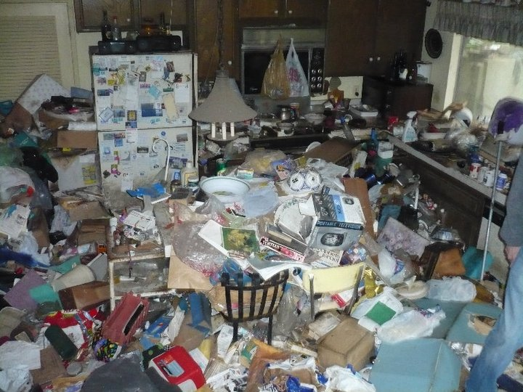
FIRE BEHAVIOR IN A STRUCTURE
FUEL LOAD

Slide 38
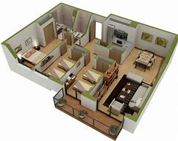
FIRE BEHAVIOR IN A STRUCTURE
FUEL ARRANGEMENT

Slide 39
FIRE BEHAVIOR IN A STRUCTURE
OXYGEN CONCENTRATIONS
6% or lower cannot support human life
• 10% or lower respiratory arrest
• 14% - Combustion will not continue
• 18% - Loss of consciousness
• 19.5 - 21% - Normal air ranges for human life

Slide 40
FIRE BEHAVIOR IN A STRUCTURE
OXYGEN CONCENTRATIONS
Related to fire
• 19.5 - 22% fire in ignition and incipient phases
1500° - 1800° F
• 16 - 18% Free burning phase
All fuels reach approx. 1100° f
• 14% or less decay phase

Slide 41
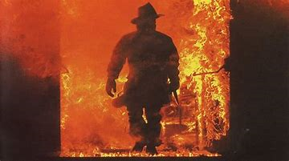
FIRE BEHAVIOR
FLASHOVER, BACKDRAFT, & SMOKE EXPLOSIONS

Slide 42
FIRE BEHAVIOR
FLASHOVER
All surfaces and objects within a space have been heated to their ignition temperature
• Flame breaks out almost at once over the surface of all objects in a space
• 16 – 20% Oxygen
• 900 – 1200° F Average Room Temperature
• Above 1300° F at Ceiling
• Very Dangerous Situation for Firefighters

Slide 43
HOW FAR DO YOU HAVE IF YOUR CAUGHT IN A FLASHOVER ?
6 - 8 FEET

Slide 44
FIRE BEHAVIOR
BACKDRAFT
Instantaneous explosion or rapid burning of superheated gases that occurs when oxygen is introduced into an oxygen – depleted confined space.
Very dangerous situation
Learn to read the signs, the smoke, the building and the fire

Slide 45
FIRE BEHAVIOR
SMOKE EXPLOSION
A similar phenomenon to a backdraft
Closed compartment suddenly erupts without a sudden opening
The only introduced oxygen is through leakage into the compartment
Can also happen above a vent hole where fuel rich super heated gases escaping a compartment mix with oxygen

Slide 46
MODERN FIRE BEHAVIOR

Slide 47
WHY??
212 FIRE FIGHTER LINE OF DUTY DEATHS FROM
2008-2015
122 OF THOSE 212 WERE ON SCENE OF FIRE
COLLABORATION BETWEEN NIST, UL, AND IAFF • MAKE OUR JOB SAFER

Slide 48
NIST STUDIES LESSONS LEARNED
Controlling ventilation has a significant impact on fire growth
Identifying and controlling flow paths helps to control fire spread
Smoke is unburned fuel
Cooling the environment to help “reset the clock”

Slide 49
MODERN FIRE BEHAVIOR
LEGACY FUELS
Traditional, natural textiles and building materials
Slower burns
Lower HRR
More time to accomplish fire ground priorities, strategies and tactics

Slide 50
FIRE BEHAVIOR
MODERN FUELS
Many modern fuels are products of Hydrocarbon fuels.
Plastics
Polymers
Methyl-Ethyl bad stuff

Slide 51
FIRE BEHAVIOR
MODERN FUELS
Many modern fuels have a much higher HRR
This means they burn hotter and faster
This in turn eats up more Oxygen in the environment
Leading to a premature decay phase
It also pushes Firefighters more to the limits of what our gear can endure and our abilities can overcome

Slide 52
FIRE BEHAVIOR
MODERN FUELS
Modern fuels are also found in building materials
This means they fail at a faster rate
Usually have less mass and surface area
Leading to early collapse with direct fire impingement
Reduces time frame in which to perform fireground functions.

Slide 53
MODERN FIRE BEHAVIOR
WHAT IS THE OUTCOME
Understanding what the fire is doing
• THERMAL Inversion layers
• Flow paths
• Ventilation limited fire

Slide 54
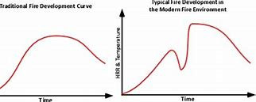
MODERN FIRE BEHAVIOR
NEW TIME TEMPERATURE CURVE

Slide 55
MODERN FIRE BEHAVIOR
UNDERSTANDING THE TIME TEMP CURVE
Ignition
Growth
Flashover
Free Burning
Decay
Rapid Growth
2nd Flashover event
Free Burning
Decay

Slide 56
MODERN FIRE BEHAVIOR
UNDERSTANDING THE TIME TEMP CURVE
What caused the second Flashover to occur?
• Rapid introduction of oxygen into fuel rich, oxygen deficient
atmosphere
• Who did that?
• Firefighters

Slide 57
MODERN FIRE BEHAVIOR
TACTICS
• Door control
• Transitional fire attack
• Heat checks
• Coordinated ventilation
• “Anchor, Darken, Terminate”

Slide 58
MODERN FIRE BEHAVIOR TACTICS
DOOR CONTROL
Limits oxygen entering structure
Reduces fire growth
Increases timeframe for attack
One person is in charge of door control
Needs to be identified before attack start

Slide 59
MODERN FIRE BEHAVIOR TACTICS
TRANSITIONAL FIRE ATTACK
Offensive fire tactic
• Cools environment from outside
• Not in IDLH
• “Resets the Clock”
• Do not confuse with transitional mode
• (moving from offensive to defensive strategies)

Slide 60
MODERN FIRE BEHAVIOR TACTICS
TRANSITIONAL FIRE ATTACK
10-15 second delivery of water into fire room
• Top corner of window
• Straight stream
• Reposition quickly or have back-up line handle it

Slide 61
MODERN FIRE BEHAVIOR TACTICS
HEAT CHECKS
Increases SA
• Doesn't allow for attack company to get too deep with fire behind and overhead
• Smoke is unburned fuel
• Stratification
• Looking for droplet return
• Short burst

Slide 62
MODERN FIRE BEHAVIOR TACTICS
COORDINATED VENTILATION
Keeps firefighter safety
• Do not open up windows or ventilation holes without coordination with attack crews
• Do not start up fans without coordination with attack crews
• Keep vent limited fires from growing too fast

Slide 63
MODERN FIRE BEHAVIOR TACTICS
“ANCHOR, DARKEN, TERMINATE”
Terms for proper application of water to fire
• Not the circles in a fire room
• Cools the superheated gasses overhead and allows for advance
• Works for advancement of hoseline and fire extinguishment

Slide 64
ENABLING OBJECTIVES
Identify the Science of Fire
Define The methods of Heat transfer
Compare the characteristics of each class of fire
Discuss fire behavior in a structure
Define Legacy Fuels vs Modern Fuels
IDENTIFY MODERN FIREFIGHTING TACTICS

