Slide 1
hose

Slide 2
NFPA Standards- Hose
NFPA 1961- Standard on Fire Hose
NFPA 1962- Standard for care, use and service testing of fire hose; including couplings and nozzles
NFPA 1963- Standard for screw threads and gaskets for fire hose connections

Slide 3
Types of Hose
Woven Hose
Wrapped Hose
Braided Hose
Rubber-covered Hose

Slide 4
Hose Construction
Yarns
  Warp- Run lengthwise
    Abrasion resistance
  Filler/Weft- Run “around” the hose
    Burst strength

Slide 5
Vulcanization Process
Combining the hose jackets
  1. The inner liner is inserted inside the outer jacket.
  2. The rubber liner is inserted inside the outer jackets.
  3. Steam is injected in between the jackets and adheres the rubber liner to the outer jackets.

Slide 6
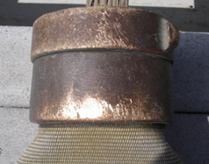
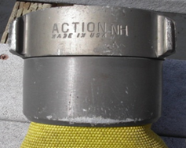
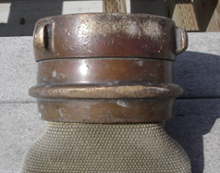
Coupling Construction
Sand Cast
  Weakest
  Loose molecular arrangement
Extruded
  Middle in strength
Drop forged
  Strongest
  Dense molecular arrangement

Slide 7
Types of Couplings
Pin Lug
  Not commonly found, snag hazard
Rocker Lug
  Most common.
Recessed Lug
  Found on Hardline
Extended Handle
  Large diameter couplings

Slide 8
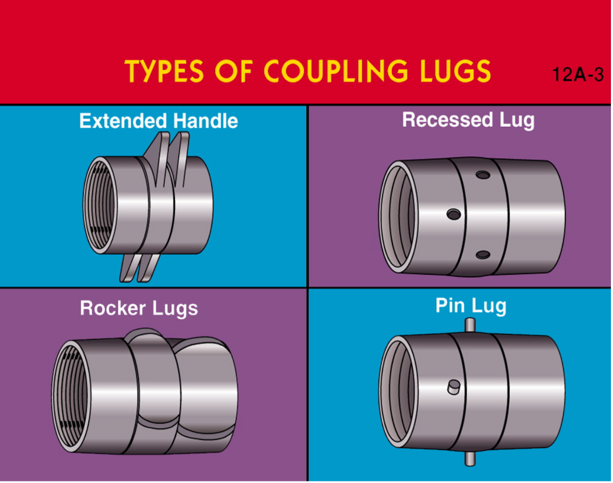

Slide 9
Parts of a Coupling
Shank
Swivel
Stil Threads
Expansion Ring
Gaskets
Lugs
Higbee Cut & Indicator

Slide 10
Coupling Inspections
Female Couplings
  G.R.O.T.S.
Male Couplings
  R.O.T.
Identify any gross damage

Slide 11
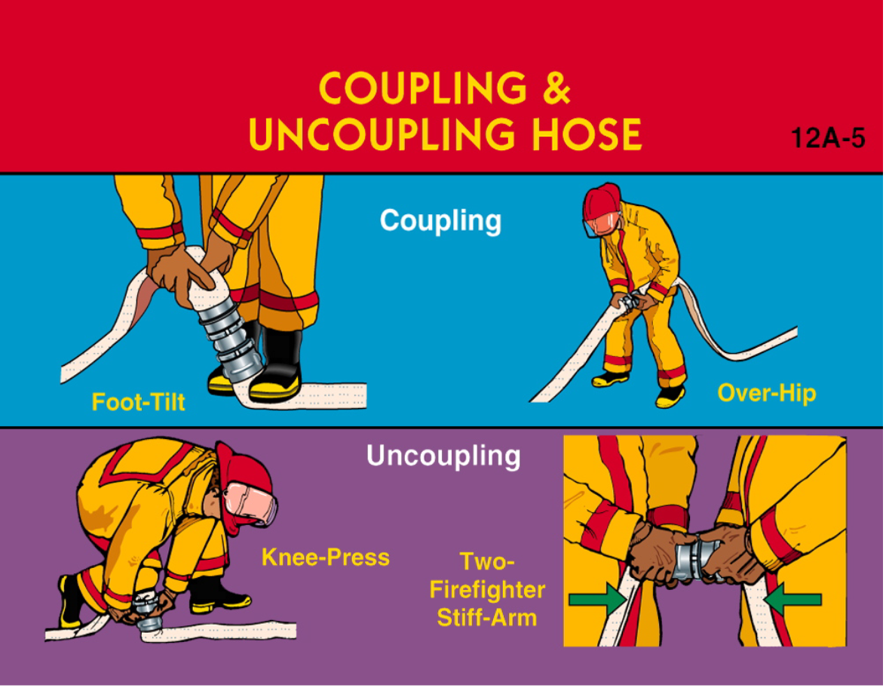

Slide 12
Types of Valves
Ball Valves
  Pumper discharges and gated wyes
Gate Valves
  Hydrants
Butterfly Valves
  Large Pump intakes
Clapper Valves
  Siamese appliances and FDC’s

Slide 13
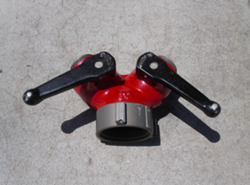
Valve Devices
  Wye appliances- 1 line into 2
  Siamese appliances- 2 lines into 1
  Water Thief appliances- Variation of Wye
    Used commonly in wildland firefighting

Slide 14
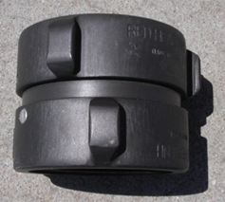
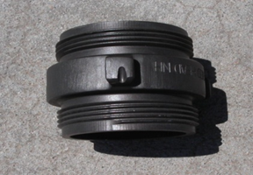
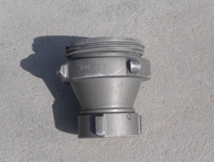
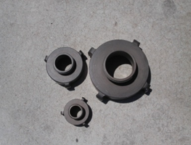
Hose Fittings
Adapters
  Double Male
  Double Female
Reducers- Follows the flow of water
Increasers- Follows the flow of water
Elbows, Caps and Plugs

Slide 15
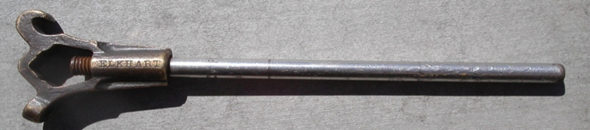
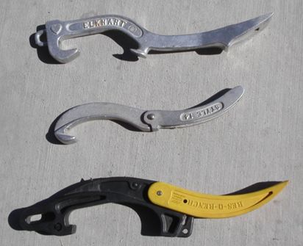
Hose Tools
  Hose Clamp
  Hydrant Wrench
    “One Line”
    Air Horn blast
  Spanner Wrench
  Rubber Mallet
  Straps, ropes and chains

Slide 16
Hose Loads
  Flat
    4”, 2 ½ “
  Preconnect Flat Load
    1 ¾” in transverse hose bed

Slide 17
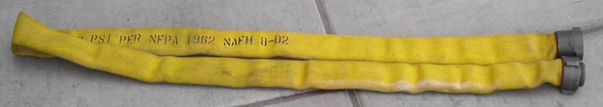
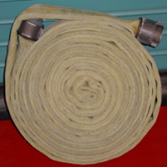
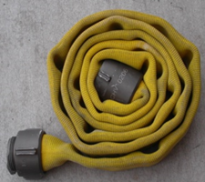
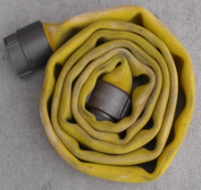
Hose Rolls-
  In-service
    Donut roll
  Out-of-Service- Damaged
    Male is unprotected
  Dirty
    Male is protected

Slide 18
Hose Lays-
  (2) 200’ 1 ¾” Preconnects- From transverse bed
  2 ½” Preconnect-
  3” Flat Load
  Hydrant lay- “One Line”

Slide 19
Type 1 Engine Hose Compliment
1 ½” Forestry- Appx. 700’ per engine
1 ¾” Attack- 750’- Preconnects, Bundles High Rise Packs
2 ½” Attack/Supply- 600’
4” Supply- 1000

Slide 20
Hose Care and Maintenance
  Rolled properly
  Cleaned with water, mild soap if needed
  Brushed
  Rinsed
  DRIED
  Re-rolled or loaded

Slide 21
Hose Testing
Service tested annually and when suspected damage
  300’ max per discharge at 250 psi for 5 minutes

Slide 22
Hose Safety Considerations
Open and Close nozzles slowly to prevent water hammer
Use back-up FF’s when needed
Walk out hose before loading
Roll hose before loading if needed
Wear proper PPE’s when working with hose (charged or re-charged)

