Slide 1
MACHINERY SPACE FIRE

Slide 2
ENABLING OBJECTIVES
State the functions and hazards of machinery spaces onboard ships/submarines.
Discuss procedures while combating a class B fire in a ships machinery rooms.
Describe post fire procedures in machinery spaces

Slide 3
MACHINERY SPACE FUNCTIONS
As the name itself suggests, the engine room is the space on the ship where all the machinery is located.
The main propulsion plant, or the main marine diesel engine that drives the propeller, is located at the bottom but could be several stories high.
Normally the engine room consists of several levels having different machinery such as auxiliary engines or diesel generators, a boiler, the inert gas plant, fresh water generator, and purifiers, fuel and oil pumps and storage tanks, the engine control room, waste incinerator, and several other common paraphernalia like electrical panels at various levels.

Slide 4
MACHINERY SPACE HAZARDS
An average size ship consumes about 40 tons of fuel oil in a day; the same amount is pumped from the double bottom tanks, and is heated, filtered, allowed to sediment, purified, clarified, conditioned, reheated, and sent to the main engine for combustion

Slide 5
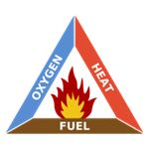
MACHINERY SPACE HAZARDS
All element's of the fire triangle are present in a ships engine rooms.
Once a fire starts the chain reaction could be catastrophic.

Slide 6
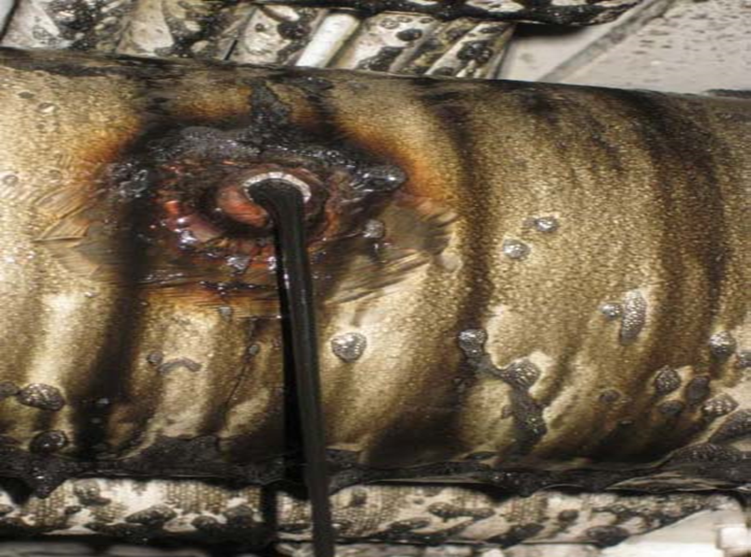
MAJOR OIL LEAK SCENERIO
Any major flammable liquid leak presents an immediate hazard which should be dealt with quickly to reduce the threat of fire.
Deflect and secure source
Apply AFFF
Remove oil
Secure machinery

Slide 7
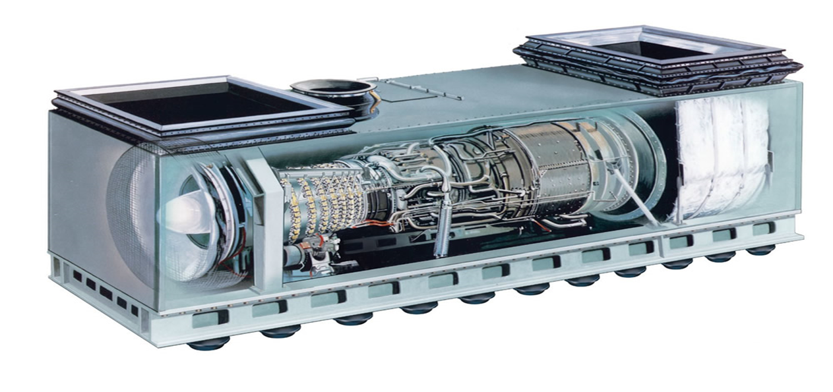
GAS TURBINE DIESAL ENGINE ENCLOSURE
Fires occur with these engines when lube oil or fuel oil gauge lines, flexible lines or filters fail & release flammable or combustible liquids onto hot surfaces

Slide 8
GAS TURBINE DIESAL ENGINE ENCLOSURE
Halon / HFP protected space procedures
If fire reflash occurs, upon entry, crack open access door & attack fire from doorway with AFFF hose (indirect attack).
If a reflash does not occur during the 15 minute Halon/HFP soak time, ventilate enclosure for another 15 minutes. HF concentration should be below 90 ppm before firefighters may enter the module

Slide 9
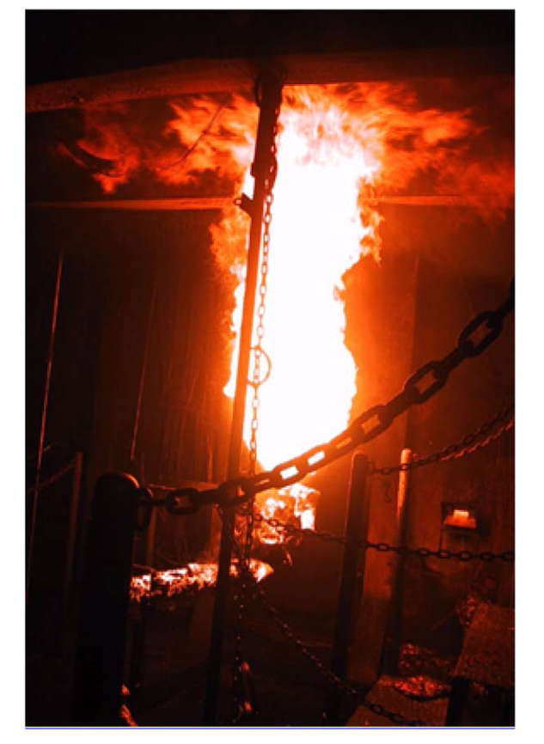
FUEL FIRE OUTSIDE MODULE
A class “B” fire can result from any pooled oil and can quickly develop from an oil spray or atomized fuel.
Establish AFFF agent & hoses
Isolate or deflect leak
Activate bilge sprinkling
Secure operating machinery
Wash fuel to bilge
Extinguish the fire
electrical/mechanical isolation
Set fire &smoke boundaries

Slide 10
OUT OF CONTROL FUEL FIRE
A class “B” fire especially one that has burned for a period of time or is fed by an un-securable fuel source, it can be out of control in seconds.
Isolate space
Set boundaries
Combat fire
Extinguish fire
Overhaul space
Ventilate
Atmospheric test

Slide 11
OUT OF CONTROL FUEL FIRE (Cont.)
Smoke Control
-Smoke control is comprised of the following areas
-Ventilation
-Smoke Boundaries
Space Isolation
The complete isolation of the affected space with the exception of lighting as necessary to prevent a fire from intensifying due to the addition of flammable liquids, oxygen and to reduce the electrical hazards.
Mechanical- Every effort shall be made to secure and isolate systems, machinery and tanks that have the potential to feed or contribute to the intensity of the fire.
Electrical- To the extent possible, all electrical equipment, with the exception of lighting, shall be secured from locations outside the affected space.

Slide 12
POST FIRE PROCEDURES
Ventilation/Dewatering & Atmospheric Testing
Ventilation should take place as soon as fire is extinguished and there is not danger of reigniting.
Dewatering spaces should be done before testing the atmosphere due to toxins being released by firefighting water. Be aware of voids and escape hatches being full of boiling water.
Contact HZ units and ships gas free personnel for this function.

Slide 13
ENABLING OBJECTIVES
State the functions and hazards of machinery spaces onboard ships/submarines.
Discuss procedures while combating a fuel fire in a ships machinery rooms.
Describe post fire procedures in machinery spaces

