Slide 1
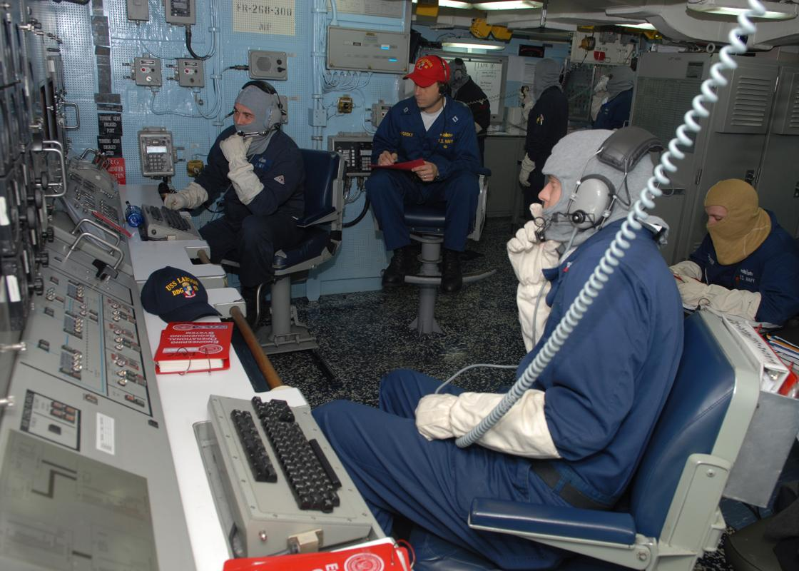
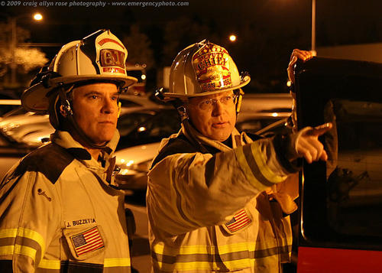
Unified Command
Unit 1.2

Slide 2
Enabling Objectives
Define and identify the primary features of Unified Command.
Describe how Unified Command functions on a multijurisdictional or multiagency incident.
List the advantages of Unified Command.

Slide 3
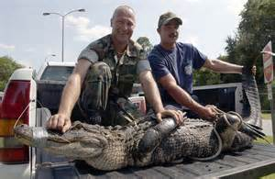
Unified Command
How can you organize incidents that cross jurisdictional boundaries or exceed individual agency responsibility / capabilities ?

Slide 4
Decision Methods
Divide the incident geographically or functionally so that each jurisdiction or agency can establish its own ICS organization
Create a single ICS Incident structure and process that has an effective and responsible multijurisdictional or multiagency approach

Slide 5
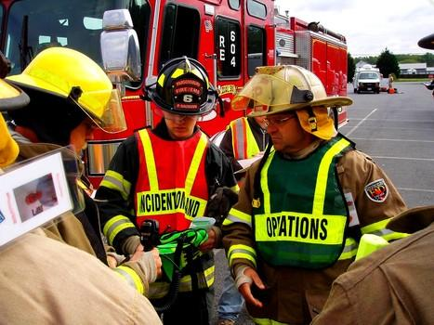
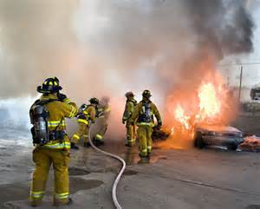
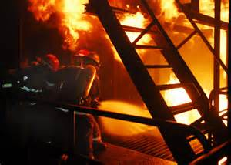
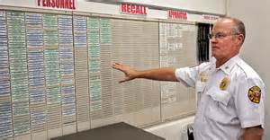
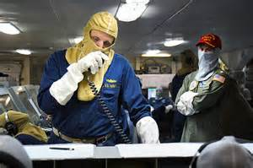
Unified Command
Enables all responsible agencies to manage an incident together by establishing a common set of incident objectives and strategies.
Allows IC to make joint decisions by establishing a single command structure.
Maintain Unity of command. Each employee only reports to one supervisor.
Incident Command Post
Agency 1
Agency 2
Agency 1 IC
Agency 2 IC

Slide 6
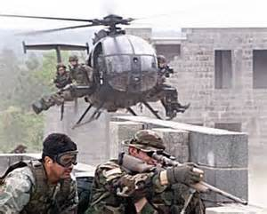
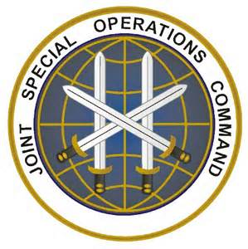
Applying Unified Command
Unified Command is :
A cohesive team effort
The US Military Has used these similar tactics to complete joint military branch objectives

Slide 7
Unified Command
Command staff
Financial / Administration
Logistics
Planning
Operations
Multijurisdictional incident
FFD Incident Command
Ships Captain Incident Command
Unified Objectives

Slide 8
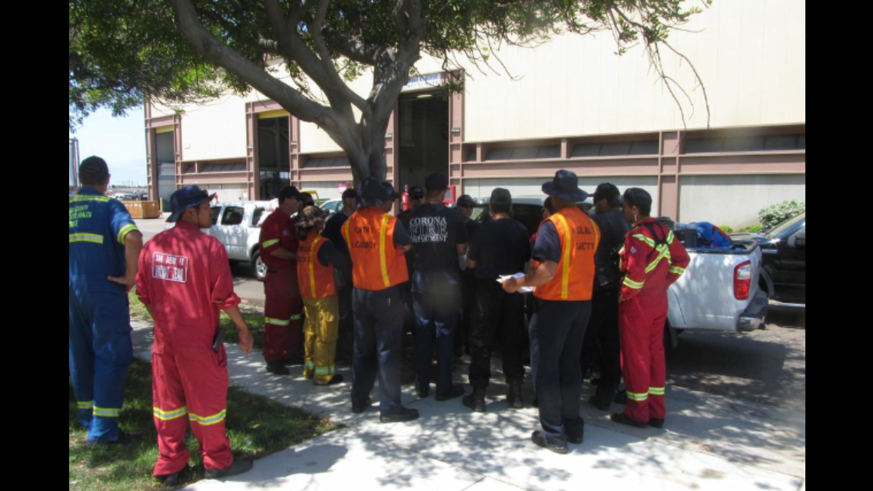
Unified Command Multiple agencies/Single jurisdiction
Incidents Involving Multiple Agencies within the same political jurisdiction
Example: During a Hazardous Materials incident, the fire department has the responsibilities of fire suppression and rescue. The police department is responsible evacuation and site security, while another agency is responsible for clean up

Slide 9
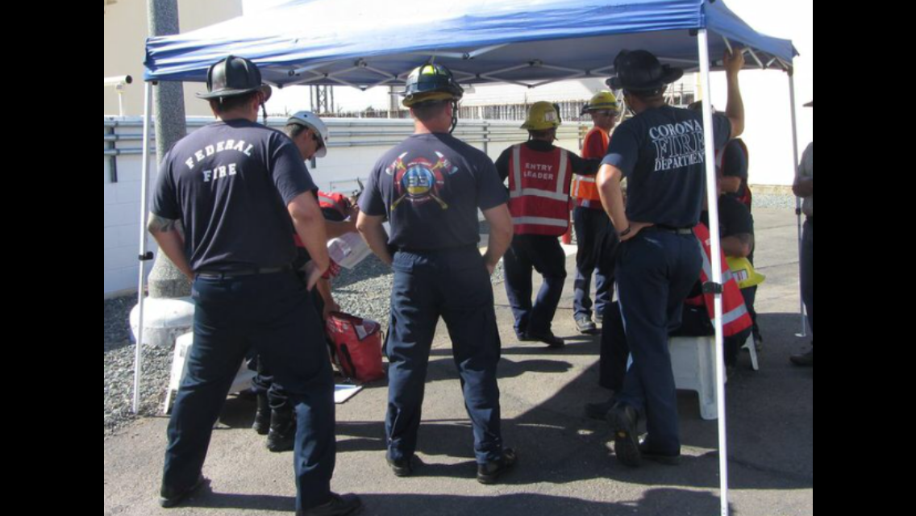
Single Integrated Incident Organization
In a Unified Command:
Jurisdictions and/or agencies blend into an Integrated, unified team.
The mix of participants depends on location of the incident and incident type.
The members MUST function together as a team.

Slide 10
Building the Team
How can we build the teamwork necessary for Unified Command?

Slide 11
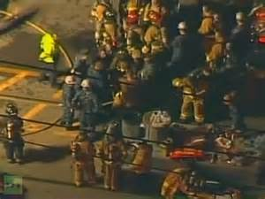
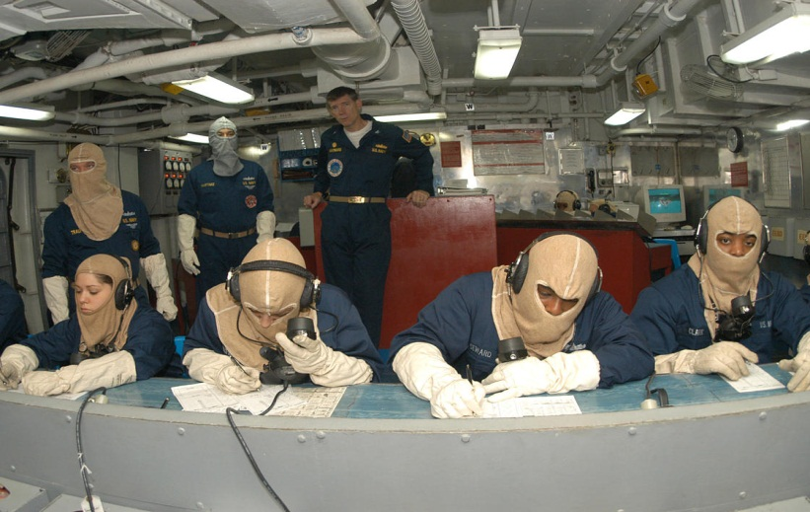
Collocated (Shared) Facilities
By bringing the responsible officials, command Staffs, and planning elements together in a single Incident Command Post, a coordinated effort can be maintained

Slide 12
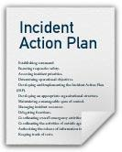
Single Planning Process
Joint Planning should be initiated as soon as two agencies form a unified command.
This planning process results in an Incident Action Plan (IAP) that addresses priorities and specifies tactical operations and resource assignments.

Slide 13
Command Meeting
The Command Meeting:
Includes all members of the Unified Command.
Takes place before the first operational period planning meeting.
Provides the responsible agency officials with an opportunity to discuss and concur on important issues prior to joint incident planning.

Slide 14
Meeting Agenda
Statement of goals
Life saving
Incident mitigation
Property preservation
Presentation of limitations and restrictions
Agreement on staff designations
Agreement on the (FLOP) procedures
Agreement on the resource ordering process
Agreement on cost sharing procedures
Designation of one agency official to act as the Unified Command spokesperson

Slide 15
Selection of the Ops Section Chief
What should be considered when selecting the Ops Chief in a Unified Command?

Slide 16
Incident Commander Responsibilities
Each agency IC functioning in a Unified Command must:
Act within their Jurisdictional limitations.
Inform the other commanders of any legal, political, jurisdictional restrictions.
Mange the incident to the best of their abilities.

Slide 17
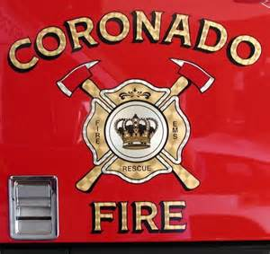
Unified Command and Preparedness
Include Unified Command delegation in Department SOP and local mutual aid agreements
Conduct training exercises using Unified Command with adjacent Agencies.

Slide 18
Advantages of Unified Command
What are the advantages of using Unified Command?

Slide 19
Advantages of Unified Command
One set of Incident Objectives
Collective approach to strategies
Improved information flow
Mutual understanding of priorities
Agency authority not compromised
Awareness of others tactics
Combined efforts are optimized
Duplicate efforts are reduced or eliminated.

Slide 20
Review & Summary
Define and identify the primary features of Unified Command.
Describe how Unified Command functions on a multijurisdictional or multiagency incident.
List the advantages of Unified Command.

