Slide 1
Developed by FFDSD Shipboard Committee
Shipboard Terminology
&
Operations

Slide 2
Enabling Objectives
IDENTIFY the different classes of ships found in San Diego Naval Stations
DESCRIBE the components of a Shipboard/Submarine Bulls Eye.
DISCUSS Shipboard/Submarine Terminology
STATE the features and characteristics of Surface Ships and Submarines.
IDENTIFY the Ships Command Structure
Describe the fire department procedures when responding to a shipboard emergency

Slide 3
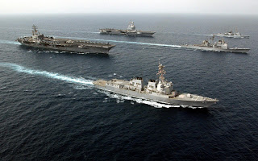
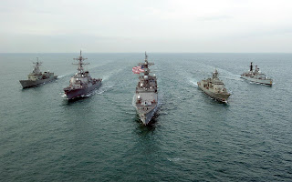
Types of Ships at Naval Station
Aircraft Carrier – CVN/CN
Amphibious Assault – LHA/LHD
L.A. Class Submarine SSBN/SS
Amphibious Transport Dock – LPD
Dock Landing – LSD
Tank Landing – LST
Destroyers – DDG
Cruisers – CG
Frigates – FFG
Mine Countermeasure Ship – MCM
Patrol Coastal – PC
Hospital Ship – T-AH
Littoral Combat Ship - LCS
Coast Guard Cutter – WHEC
Other Various Ships or Vessels – Tugs, Oilers, Repair, Berthing, Research, and Ships visiting from other nations

Slide 4
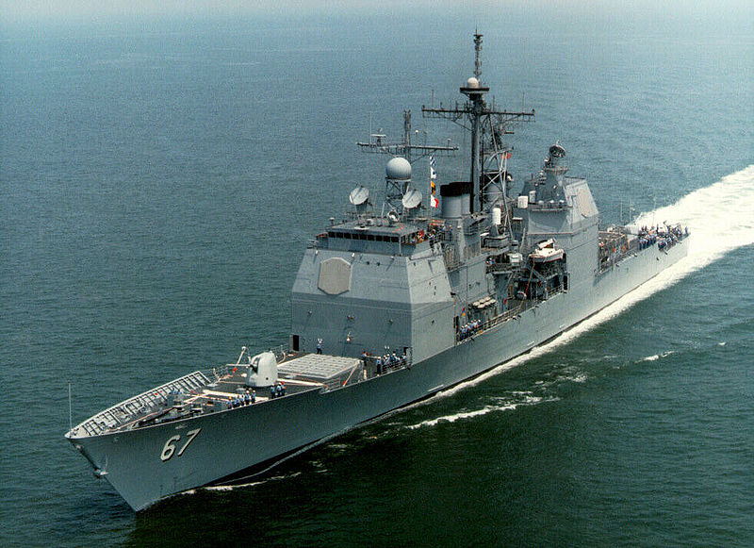
Ship Hull Numbers
EXAMPLE CG-67 USS SHILO
CG = Cruiser Hull # = 67 Name = Shilo
On the stern and side of the bow

Slide 5
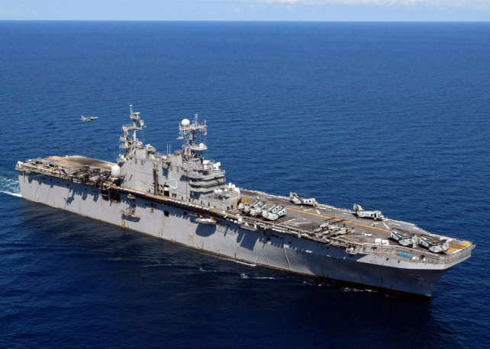
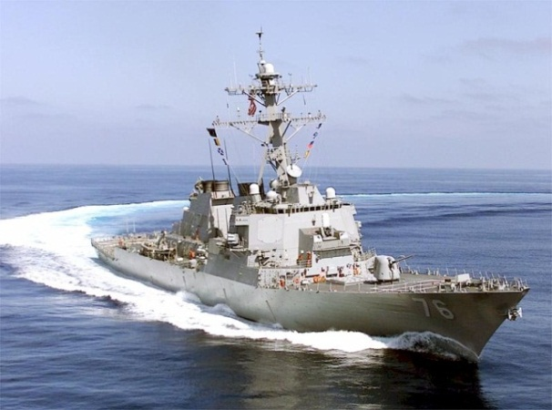
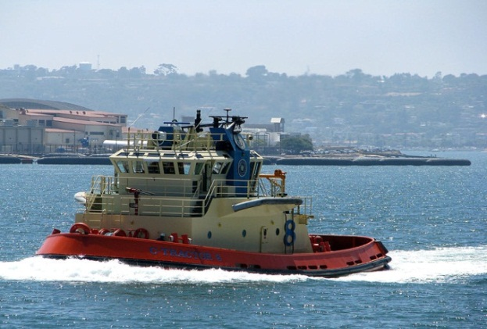
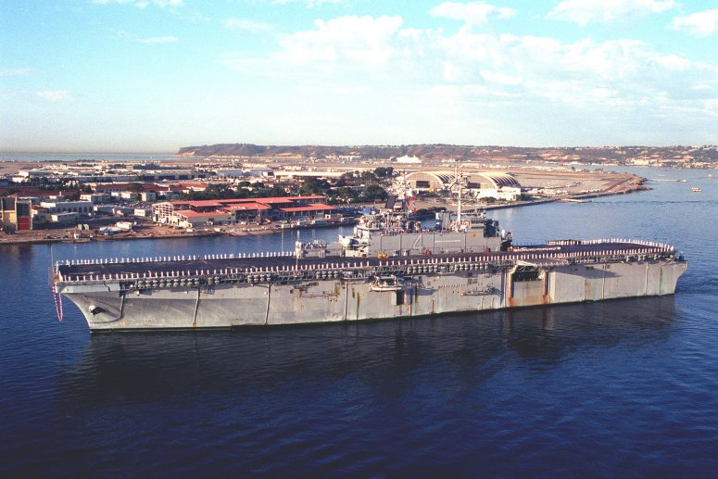
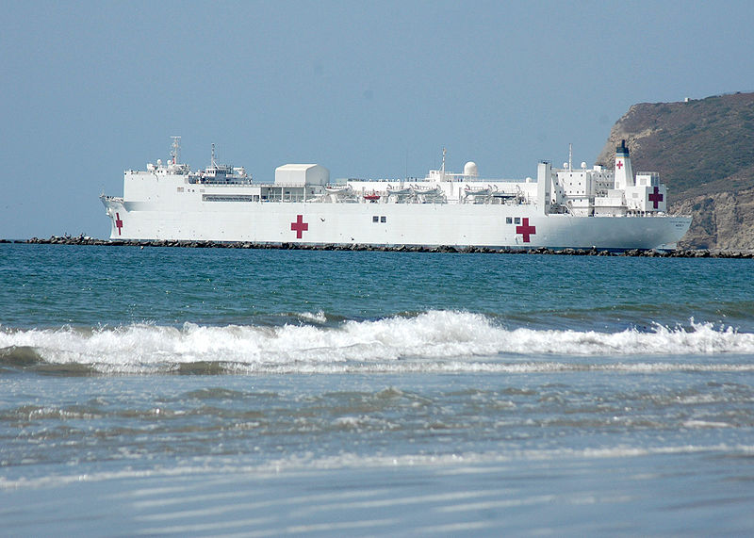
Ships
LHA-5 Peleliu | DDG-76 USS Higgins | Tug C-Tractor 8
LHD-4 Boxer | CG-67 USS Shilo | T-AH-19 USS Mercy

Slide 6
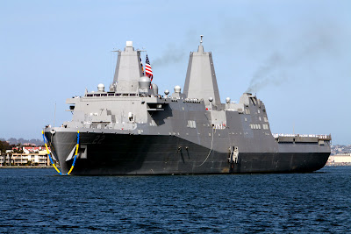
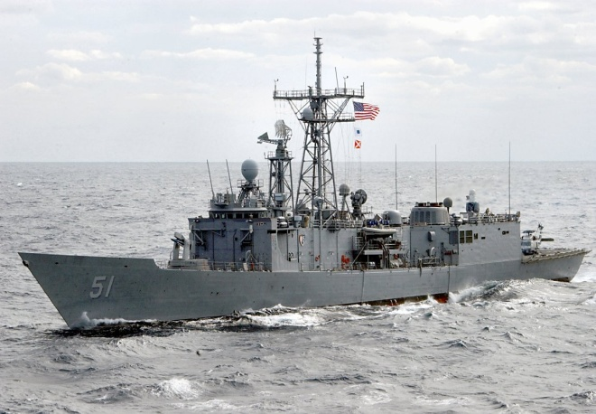
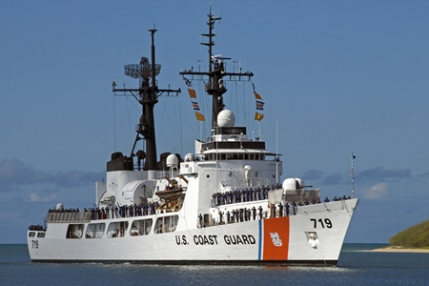
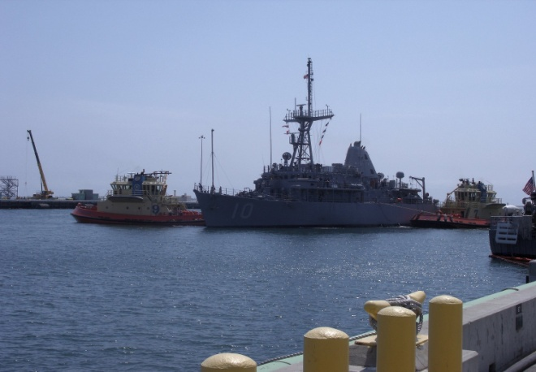
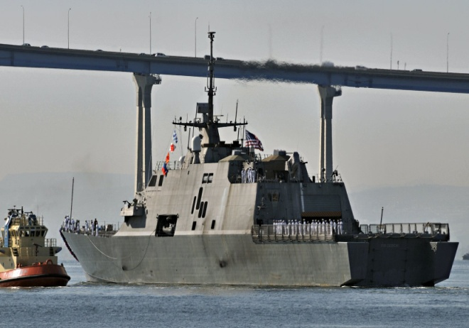
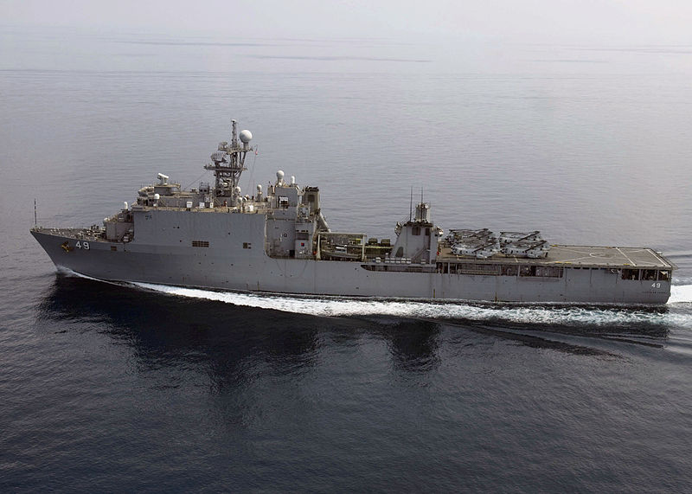
Ships
LPD-22 USS San Diego | FFG-51 USS Gary | USCGC BOUTWELL (WHEC 719)
LSD-49 USS Harpers Ferry | MCM-10 USS Warrior | LCS-1 USS Freedom

Slide 7
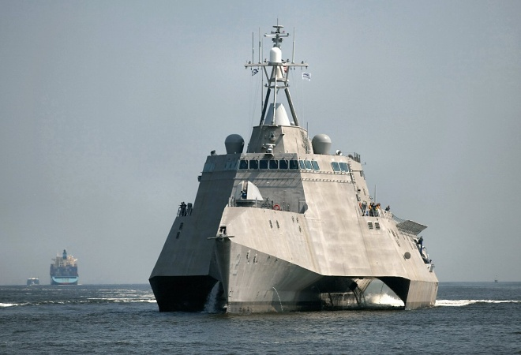
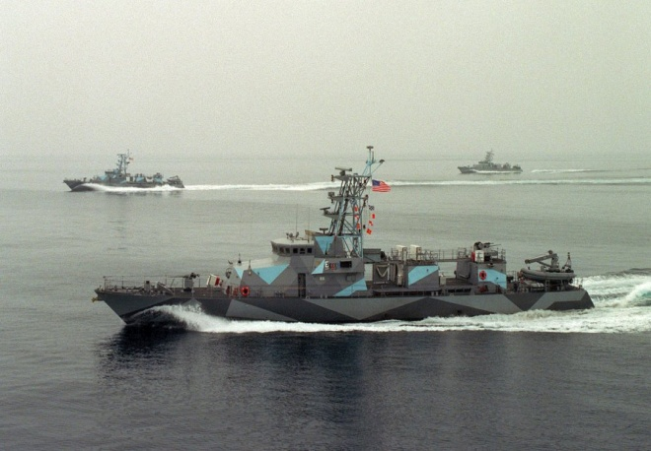
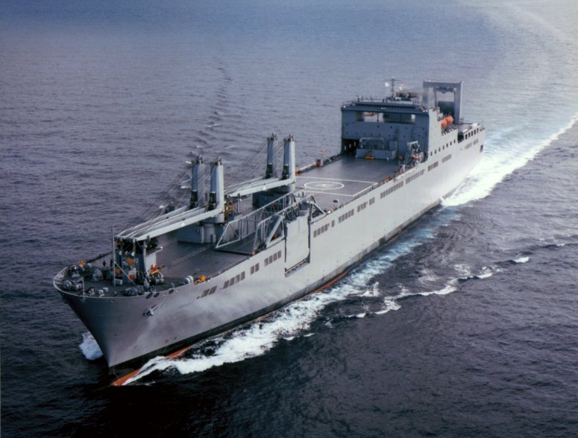
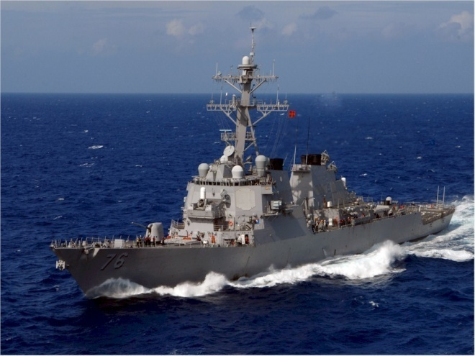
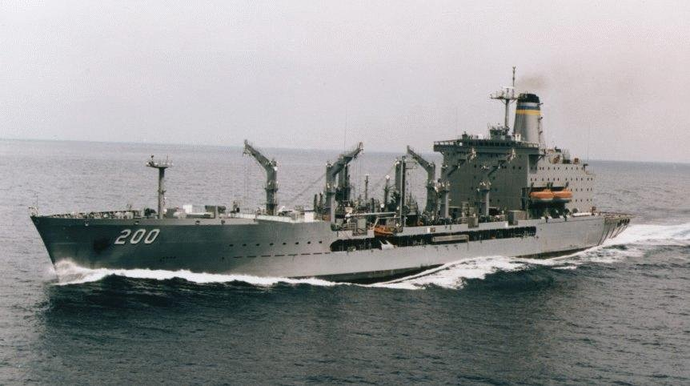
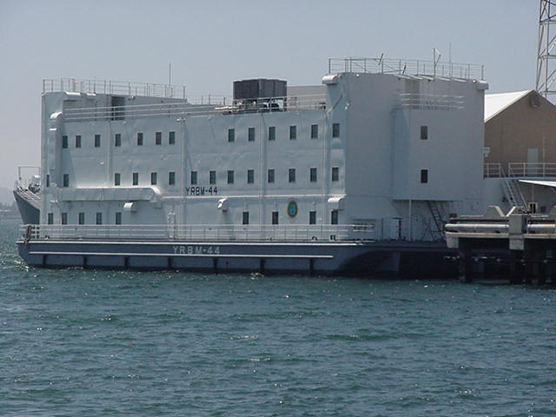
Ships
LCS - 2 USS Independence | PC-3 USS Hurricane | T-AKR USNS Bob Hope
DDG -76 USS Higgins | TAO-200 USNS Guadalupe | Berthing Barge YRBM

Slide 8
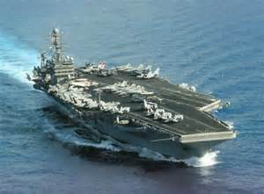
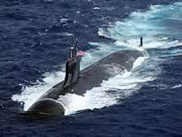
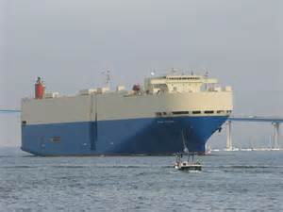
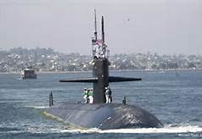
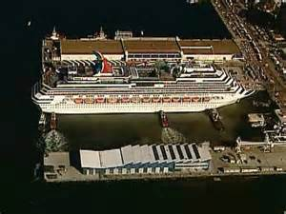
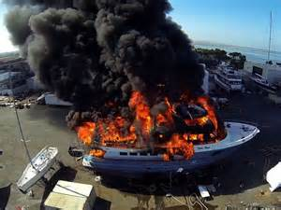
Ships
CVN-73 USS George Washington | SSN-21 USS Cave Lupum | NYK Cargo Ship
SSN-700 USS Dallas | Carnival Cruise Liner | Pleasure Yacht

Slide 9
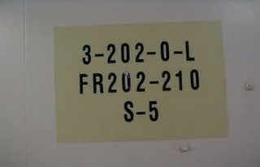
Compartment Numbering & Type
3-202-0-M
Living Space Compartment
The Centerline To Port
Forward Boundary Is On Or Immediately Forward Of Frame 202
Third Deck

Slide 10
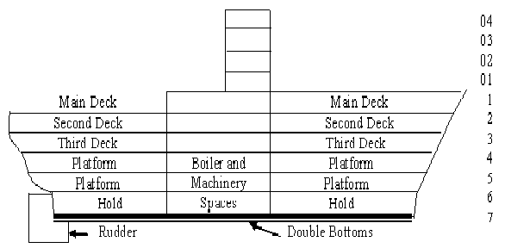
Decks
Military Ships built after March 1949

Slide 11
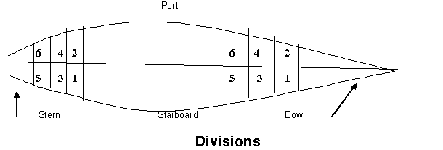
Divisions

Slide 12
Compartment Letters For Ships
Letter | Type of Compartment | Examples
 | Stowage Spaces | Store And Issue Rooms; Refrigerated Compartments
AA | Cargo Holds | Cargo Holds And Cargo Refrigerated Compartments
C | Control Centers And Fire Control Operations (Normally Manned). | CIC; Plotting Rooms; Communication Centers; Pilothouse; Electronic Equipment Space.
E | Engineering Control Centers (Normally Manned). | Main Machinery Spaces; Evaporator Rooms; Steering Gear Rooms; Pump Rooms; Generator Rooms.
F | Oil Stowage Compartments (For Use By Ship) | Fuel, Diesel, And Lubricating Oil
FF | Oil Stowage Compartments (Cargo) | Compartments Carrying Various Types Of Oil As Cargo.
G | Gasoline Stowage Compartments (For Use By Ship) | Gasoline Tanks, Cofferdams, Trunks And Pump Rooms.
GG | Gasoline Stowage Compartments (Cargo) | Spaces For Carrying Gasoline As Cargo

Slide 13
Letter | Type of Compartment | Examples
J | JP-5 Fuel (For Use By Ship) | Jet Fuel Storage Spaces
JJ | JP-5 Fuel (Cargo)
K | Chemical And Dangerous Materials (Other Than Oil And Gasoline). | Hazardous Materials For Ships Use Or As Cargo
L | Living Spaces | Berthing And Mess Spaces, Staterooms, Washrooms, Heads, Brig, Sickbay, And Passageways
M | Ammunition Spaces | Magazines, Handling Rooms, Turrets, Gun Mounts, Shell Rooms, And Ready Service Rooms
Q | Miscellaneous Spaces Not Covered By Other Letters | Laundry, Galley, Pantries, Wiring Trunks, Unmanned Engineering, Electrical/Electronic Spaces, Shops And Offices
T | Vertical Access Trunk | Escape Trunks
V | Voids | Cofferdam Spaces (Other Than Gasoline), Void Wing Compartments
W | Water Stowage Spaces | Drainage Tanks, Fresh Water Tanks, Peak Tanks, And Reserve Feed Water Tanks.

Slide 14
Shipboard Terminology
Aft: Toward the stern of the vessel.
Bilge: The lowest inner part of a ship's hull.
Bow: Front end of boat or vessel.
Bulkhead: (Wall) One of the upright, vertical partitions dividing a ship into compartments and serving to retard the spread of leakage or fire.
Centerline: Also known as the “Lubbers line,” a line that runs from the bow to the stern of the vessel and is equal distances from the port and starboard sides of the vessel
Vestibule: Interior stair-ladder used to travel from deck to deck, usually enclosed.
Repair Locker: A locker used for the storage of emergency equipment.
Deck: A platform (floor) extending horizontally from one side of a ship to the other.

Slide 15
Shipboard Terminology
Dewatering: Process (if removing water from a vessel.
Escape Trunk: A vertical trunk fitted with a ladder to permit personnel to escape if trapped.
Fantail: The stern overhang of a ship.
Fire Station: A location for fire fighting water supply outlet, hose, and equipment on board ship.
Forward: Toward the bow of the vessel.
Frame: Structural members of the vessel that attaches perpendicularly to the keel to form the ribs of the vessel.
Gangway: Opening through bulwarks (sides) of a ship or a ship's rail to which an accommodation ladder used for normal boarding of the ship is attached.
Ladder: All staircases, often almost vertical, onboard vessels.
Main Deck: The upper most continuous deck of a ship, which runs from bow to stern.

Slide 16
Shipboard Terminology
Overhead: A vessel's equivalent to a ceiling.
Passageway: A corridor or hallway.
Port Side: The left-hand side of a ship as one faces forward.
Starboard Side: The right-hand side of a ship as one faces forward.
Stern: Rear end of boat or vessel.
Superstructure: Enclosed structure above the main deck, which goes from one side of the vessel to the other side.
Watertight Bulkhead: A bulkhead (wall) strengthened and sealed to form a barrier against flooding in the event that the area on one side of it fills with liquid.
Watertight Door: A door that is designed to keep water out.

Slide 17
Ship’s Command
CO: Commanding Officer
XO: Executive Officer
CDO: Command Duty Officer
DCO: Engineering Officer in charge of Damage Control
DCA: Damage Control Assistant in charge of Firefighting
FM: Fire Marshal
RPL: Repair Locker Leader
OSL: On-Scene Leader
ATL: Attack Team Leader

Slide 18
Ship’s Damage Control Positions
Rapid Response Team (RRT): Go directly to scene, employ portable extinguishers to control or put out fire. Four-person minimum with Fire Marshall and Electrician
Investigator: Wears SCBA, constantly search all surrounding boundaries for fire, damage and personnel casualties / monitor smoke and fire boundaries, made reports to (RPL or Fire Marshall or OSL) using the best means available
Fire Marshall: Proceeds directly to the fire to direct efforts with RRT / maintains big Picture role boundaries / vertical fire spread
On Scene Leader – OSL: In charge at the scene / receive reports from team leader / investigators / decides PPE and method of attack.
Repair Locker Leader (RPL): Officer / Chief Petty officer in charge of all personnel and locker area communications / boundaries / mechanical and electrical isolation / DC plotting and training.

Slide 19
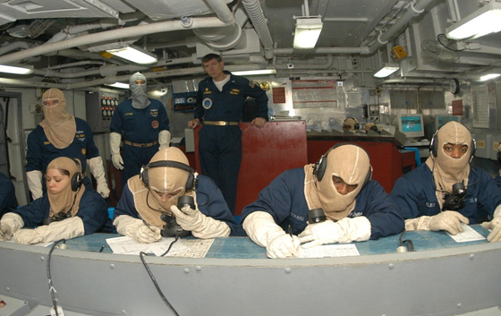
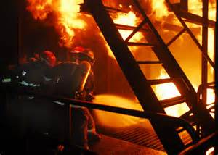
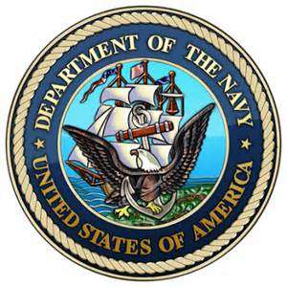
Ship’s Damage Control Positions
Team Leader: In charge of attack team, Makes reports to the OSL / wears an SCBA / operates NFTI (Thermal Imaging) when required / direct nozzle man / establish communications with OSL.
Gas Free Engineering Petty Officer (GFEPO): Wears SCBA, performs post fire atmosphere testing

Slide 20
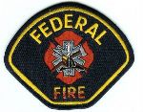
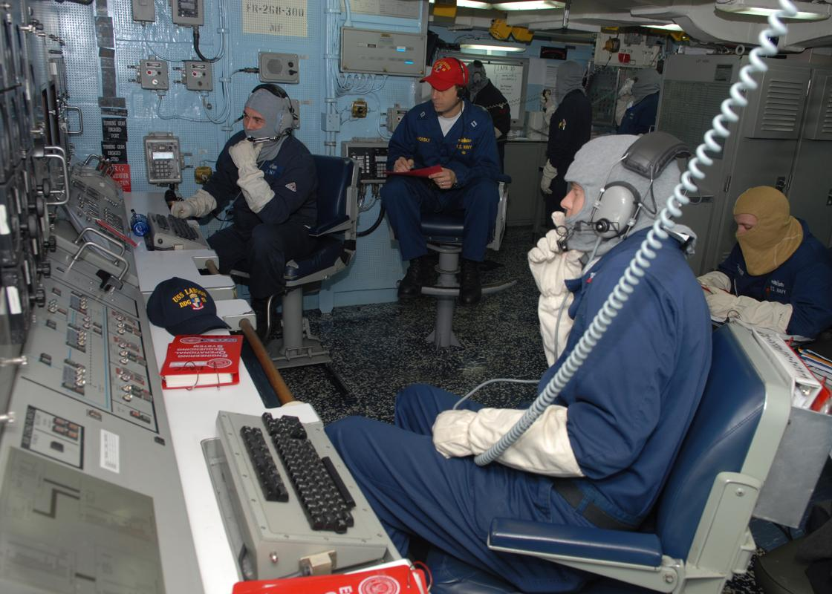
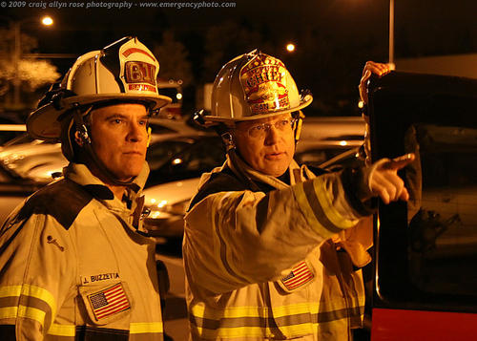
Shipboard Operations

Slide 21
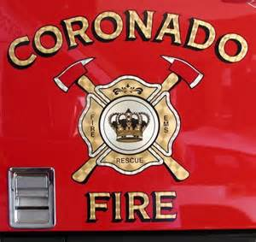
Unified Command and Preparedness
Include Unified Command delegation in Department SOP and local mutual aid agreements
Conduct training exercises using Unified Command with adjacent Agencies.

Slide 22
Federal Fire Department Procedures
Size-up - Problem identification / Investigation
Strategy and Tactics- Action plan
Implementation - Tasks

Slide 23
Size-up - Problem Identification / Investigation
First in Engine will respond to the vessels quarterdeck access in investigating mode
Remaining apparatus will stage at the pier access gate / or on the quay wall (primary staging) awaiting assignment
Minimum response is 3 engines / truck crews and a battalion chief.
First in FFD company officer will meet ship's CDO or DCA at the Quarterdeck to determine the vessels assistance needed and acquire the information needed to provide that assistance
If necessary company officer may be escorted to Damage Control Central for information

Slide 24
Size-up - Problem Identification / Investigation
Information Needed by First in Officer
Location of fire, compartment(s), deck(s), uses, and exposures
What class(s) of fire presently.
What measures have been done to combat the fire, systems activated?
How many personnel are available on the vessel to combat the incident.
Have non-essential personnel been evacuated from vessel.
Obtain damage control plates (Firefighting Plans) from USN or view electronically in DCC
Communications. Fire officer in DC Central or radio communications with DC Central
Hazards involved

Slide 25
Strategy and Tactics- Action Plan
First in FFD company officer will establish or pass Incident Command depending on the personnel on scene.
IC will call for additional resources as needed (at least a second alarm if engaging)
IC will determine the plan of action based on the ship’s assistance required and will assign command positions until relieved by a Staff Officer
Plan of Action will determine Point of entry , Hose needed, and location to position pumping engine for hose deployment

Slide 26
Strategy and Tactics- Action Plan
Command assignments for first alarm
IC – 1st Company officer until relieved by Battalion Chief and will then assume Op’s
OP’s - 1st Company officer until relieved second staff officer
Hose deployment crew – 3 person crew including crew leader
Attack – 3 person crew including crew leader
RIT – 3 person crew including crew leader
Pump operator
Accountability
Think about acquire WIFCOM radio’s and or use conventional mode for interior crews communications (minimum 4)

Slide 27
Implementation - Tasks operations on vessel
IC / OP’s remain in communication with ships DCA or delegate for unified command
1st alarm crews will board the vessel and report to the IC position on the vessels deck location for assignment briefings and the staging of their equipment.
1st alarm crews equipment brought aboard will consist of Full PPE, Spare SCBA bottles, TIC, Rope Bag, 2 hose packs, Light box, and accountability tags.
IC briefs Hose deployment crew on loading location, and length needed to reach point of entry (normally 3” Hose with gated wye)
IC briefs Attack crew on communication method, location of fire, class of fire, progress by ships crew, hazards involved or in a exposed compartment. Crew reports to point of entry . IC should request ship for a crew member to guide first attack crew to location.

Slide 28
Implementation - Tasks
Operations on vessel
IC briefs RIT crew on communication method, location of fire, class of fire, progress by ships crew, hazards involved or in a exposed compartment. Crew reports to point of entry in ready standby mode . RIT crew brings RIT pack along with normal equipment.
Accountability reports to the point of entry. Accountability SOG in use. Keep track of a 15 minute IDLH time.
Pump operator will position engine according to hose deployment location. Pump operator is responsible for his water supply. Pier water risers have 400 gpm and hydrants at the pier heads have 1200 gpm. Risers are adequate unless IC determines otherwise.
Support vessels fire main if necessary
Set up rehabilitation / Medical on deck or pier
Incident Command Post on pier or quay wall
Assign a apparatus staging area for 2nd alarm of greater

Slide 29
Positioning and Water Source

Slide 30
Positioning and Water Source

Slide 31
Review & Summary
IDENTIFY the different classes of ships found in San Diego Naval Stations
DESCRIBE the components of a Shipboard Bulls Eye.
DISCUSS Shipboard Terminology
STATE the features and characteristics of Surface Ships
IDENTIFY the Ships Command Structure
Describe the fire department procedures when responding to a shipboard emergency

